Slide 1
DATA SETS
Statistics

Slide 2
INTRODUCTION
  I will analyze the relationship between age and the number of bedrooms people rent.
  I will also determine the distribution for age and perform hypothesis testing.
  Age is continuous and also ratio since it has a meaningful zero. Since number of bedrooms can be counted, it is discrete and ratio.
  I am going to analyze the descriptive statistics, linear regression.

Slide 3
Descriptive Statistics
The number of people in this dataset is 1728.
The average age in this dataset is 25.457 years-old.
The median is 22 while the mode is 28.
The oldest person in this dataset is 115 years-old while the youngest person is 1 year-old.
The standard deviation is 17.952.
The average number of bedrooms is approximately 3.
The median and the mode are both 3.

Slide 4
Linear Regression
From the linear regression results we see that the correlation coefficient is 0.017518. This means that the relationship between the age and the number of bedrooms rented weak.
There is little to no relationship between the two.
This is also evident from the scatter plot. There is no relationship between them.

Slide 5
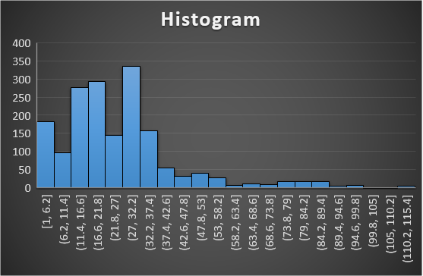
Histogram
We can analyze the distribution of age using an histogram.
From the histogram below, we can see that the distribution of age from the dataset is right-skewed (positively skewed).
Most people are aged between 1 and 42 years-old.

Slide 6
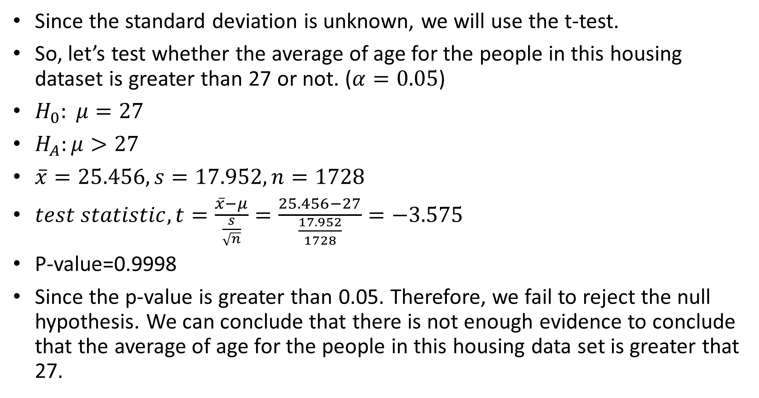
Hypothesis Testing
Since the standard deviation is unknown, we will use the t-test.
So, let’s test whether the average of age for the people in this housing dataset is greater than 27 or not. ($α=0.05$)
$H_{0}: μ=27$
$H_{A}:μ>27$
$\overline{x}=25.456, s=17.952, n=1728$
$test statistic, t=\frac{\overline{x}−μ}{\frac{s}{\sqrt{n}}}=\frac{25.456−27}{\frac{17.952}{1728}}=−3.575$
P-value=0.9998
Since the p-value is greater than 0.05. Therefore, we fail to reject the null hypothesis. We can conclude that there is not enough evidence to conclude that the average of age for the people in this housing data set is greater that 27.

Slide 7
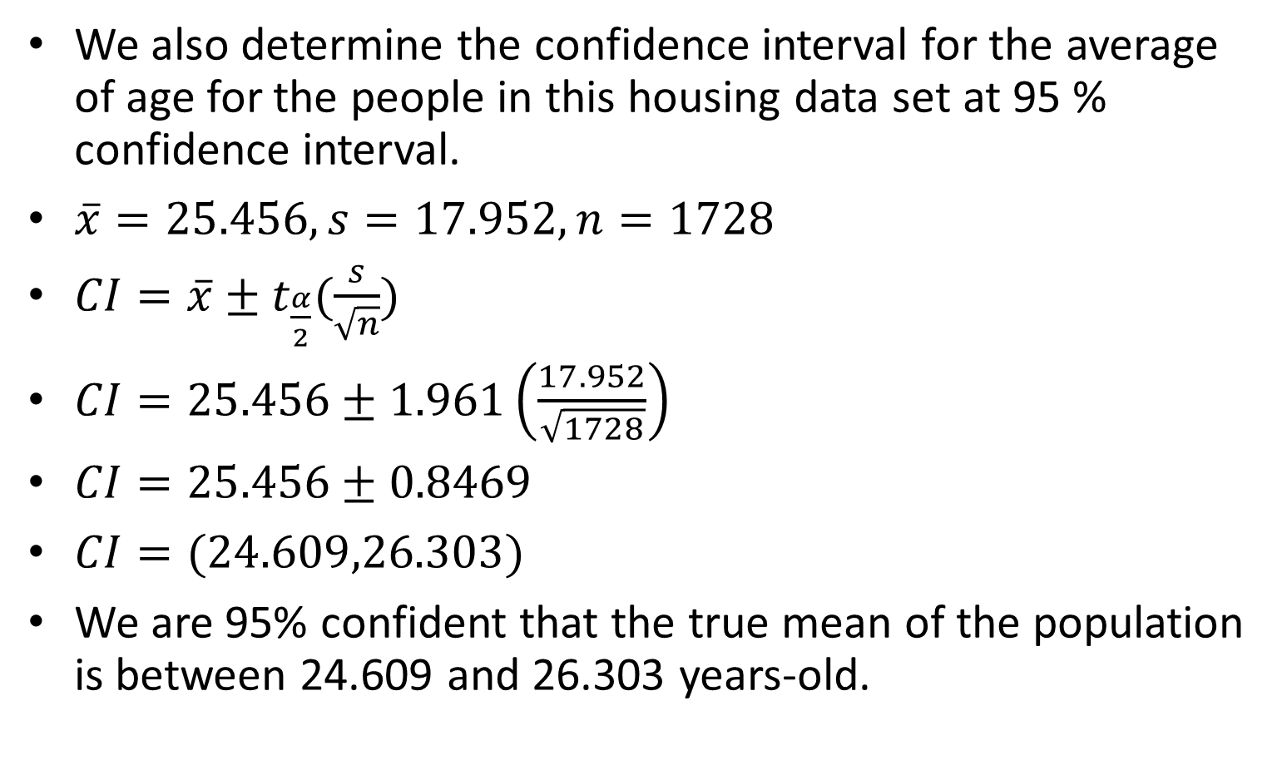
Confidence Interval
We also determine the confidence interval for the average of age for the people in this housing data set at 95 % confidence interval.
$\overline{x}=25.456, s=17.952, n=1728$
$CI=\overline{x}±t_{\frac{α}{2}}(\frac{s}{\sqrt{n}})$
$CI=25.456±1.961\left(\frac{17.952}{\sqrt{1728}}\right)$
$CI=25.456±0.8469$
$CI=(24.609,26.303)$
We are 95% confident that the true mean of the population is between 24.609 and 26.303 years-old.

Slide 8
Summary & Conclusion
The mean age is 25.456, the median is 22, and the mode is 28.
The mean number of bedrooms is 3. The median and the mode are also 3.
There is no relationship between age and the number of bedrooms rented in this dataset.
Age is positively skewed (right-skewed) where by most people are aged below 42 years-old.
From the hypothesis testing, we conclude that there is not enough evidence to conclude that the average of age for the people in this housing data set is greater that 27.

